Slide 1
CUSTOMER ANALYSIS DASHBOARD
File created on: 10/21/2023 12:14:41 AM

Slide 2
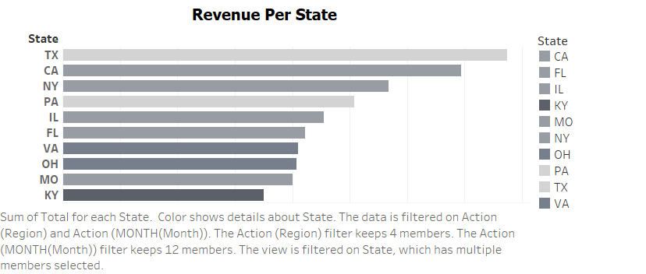

Slide 3
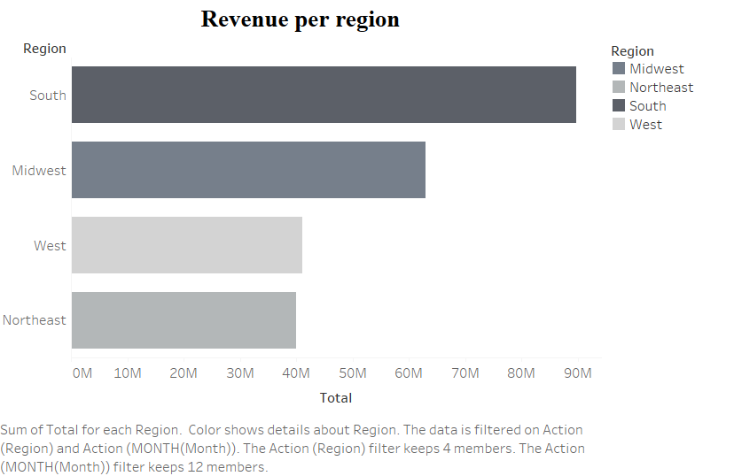

Slide 4
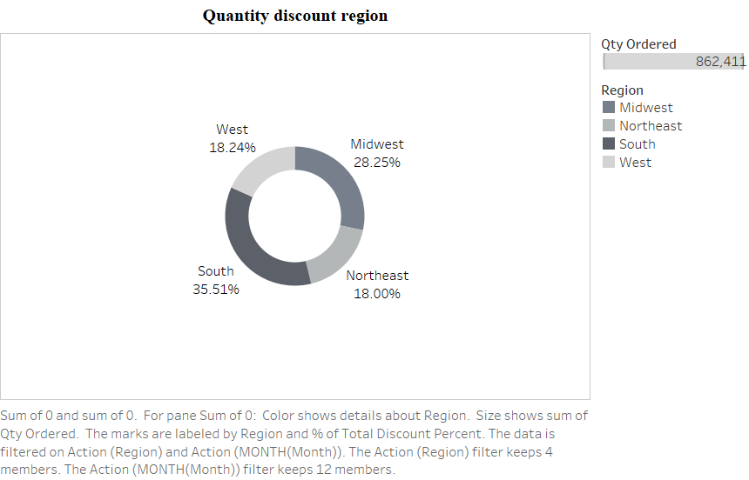

Slide 5
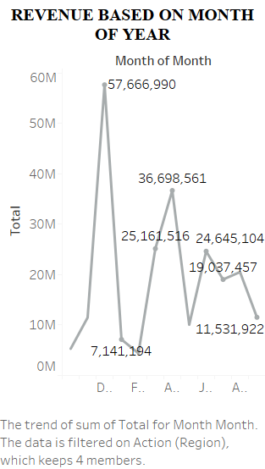

Slide 6
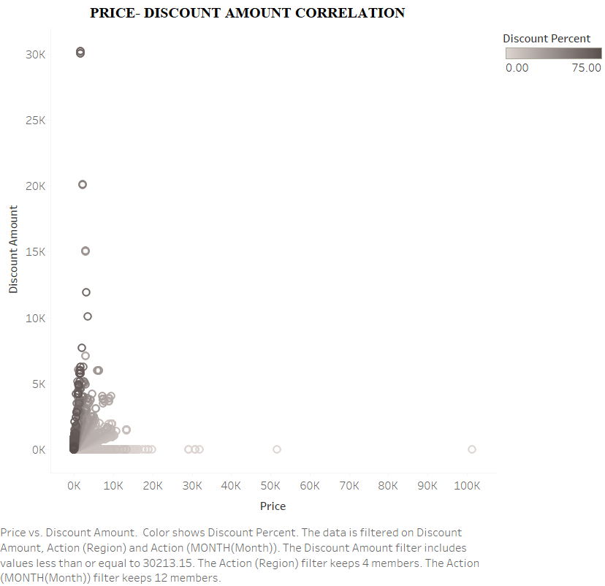

Slide 7
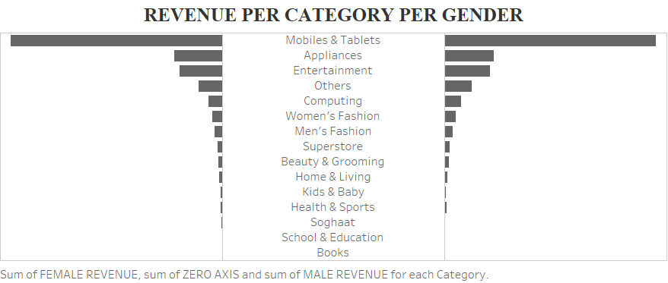

Slide 8
